Slide 1
I2EC'20
Using Domain Knowledge:
An Extended Example
ZheFei Chen

Slide 2
I2EC'20
- Brief Introduction of a Cargo Transportation System
- Basic Requirements
- Intuitional Model Design & System Construction
- The Drawbacks
- Improve the Former Design
- Domain Knowledge Extraction
- Model Isolation & Association
- Divide AGGREGATE
- Model Check
- Features for Example
- Conclusion
ZheFei Chen

Slide 3








I2EC'20
A Brief Introduction of Cargo System
Basic Requirement: Transport
drive/load/unload
Before Transport: Customers Appoint
cargo
transportation
During Transport: Get Location
order
After Transport: Sending Invoice
location
invoice
ZheFei Chen

Slide 4
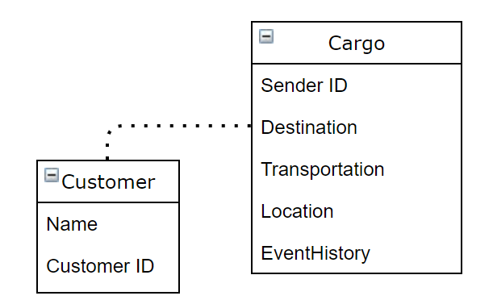
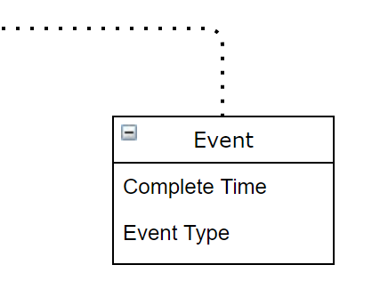
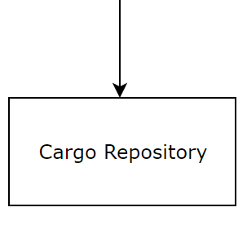
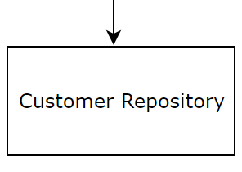
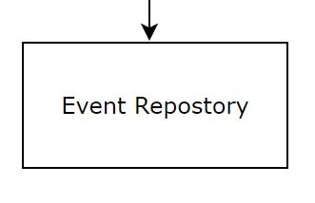
I2EC'20
Intuitional Model Design
Basic Class: Customer & Cargo
Additional Class: Event
load、unload、movement
Persistence: Repository
Problems:
Details not spicificly separated
Cargo Instance hard to understand
ZheFei Chen

Slide 5
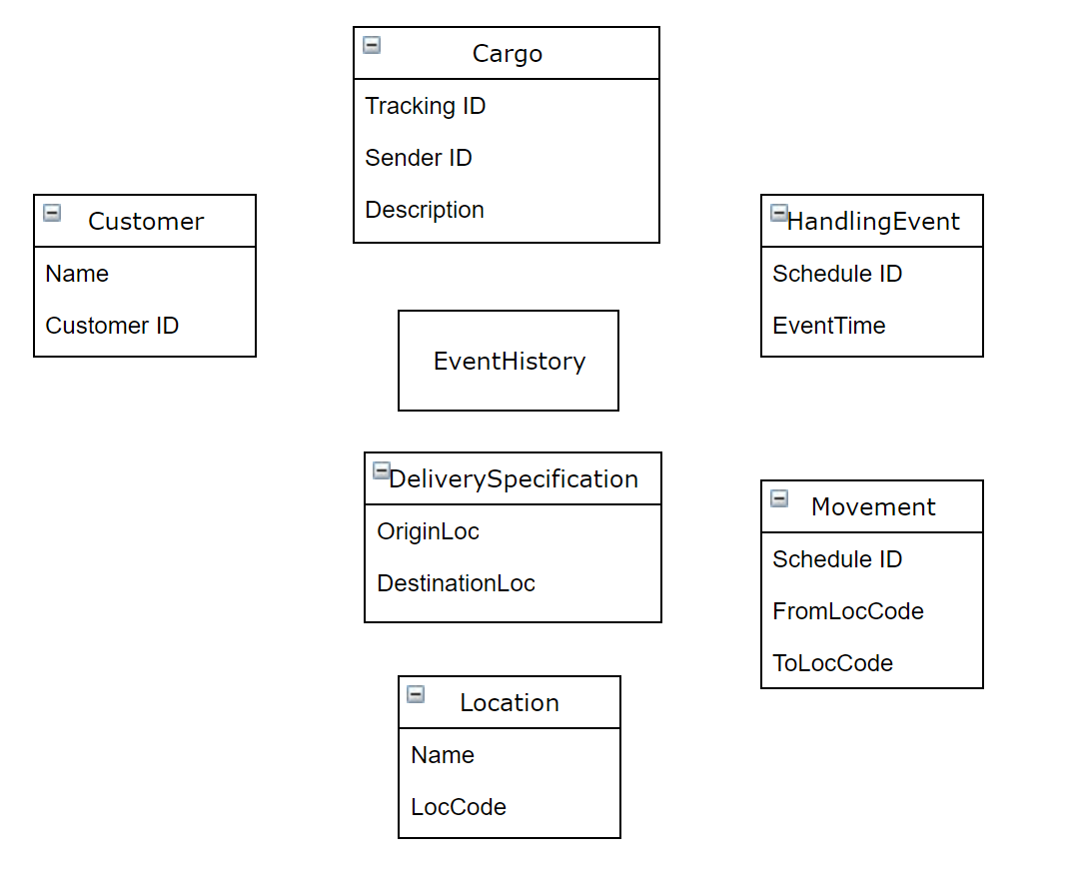
I2EC'20
Improve The Former Design
Step1: Domain Knowledge Isolation
Ubiquitous Language Description:
- A Cargo covers several Customers
- Cargo's Transportation Goal is assigned
- To complete the Goal we need some Specifications to describe the behavior of Delivery
Isolation(Every Object has a Clear Meaning):
· Seperate DeliverySpecification & EventHistory from Cargo
· Seperate Location from Delivery
· Seperate Movement from Event
Advantages:
- Make Cargo and HandlingEvent more simple to understand and modify
- Clearly State the Functions
- Ignore some details easily and safely(Using Specification)
ZheFei Chen

Slide 6
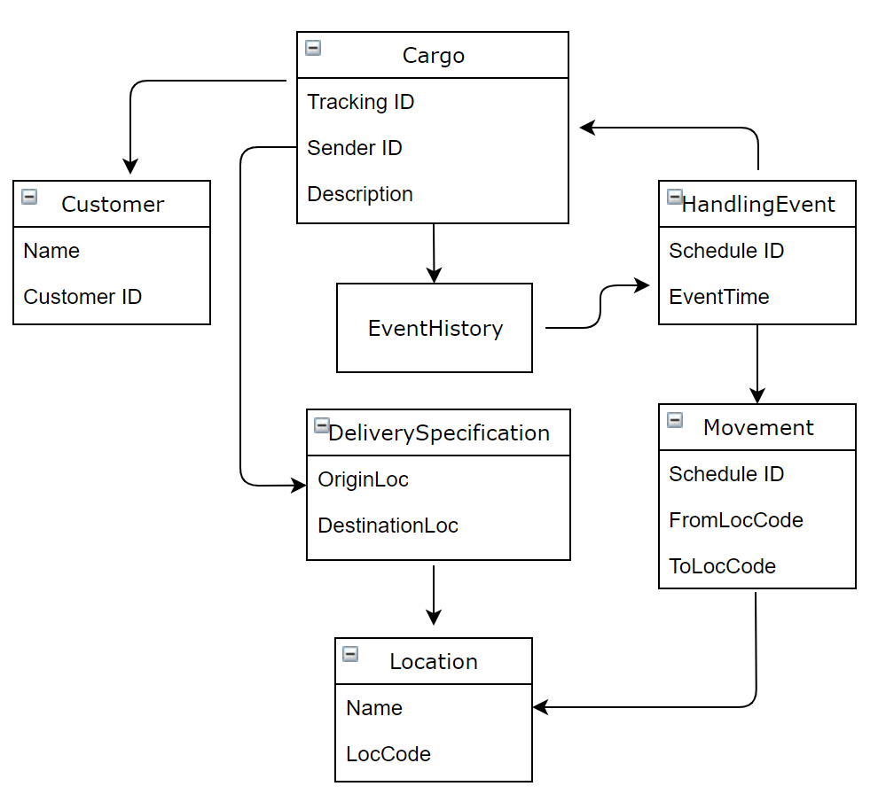
I2EC'20
Improve The Former Design
Step2: Domain Knowledge Association
If the Customer has a direct reference to every Cargo it has shipped, it will become cumbersome for long-term, repeat Customers.
Here a circle is defined because we do need to follow cargo by its events
We just need to get a Cargo's trail, so link from Movement to HandlingEvent is unnecessary
Use a Specification to claim the goal of a Crago instance
Location may be used by many instances, so it needs to be seperated from delivery's private members
ZheFei Chen

Slide 7
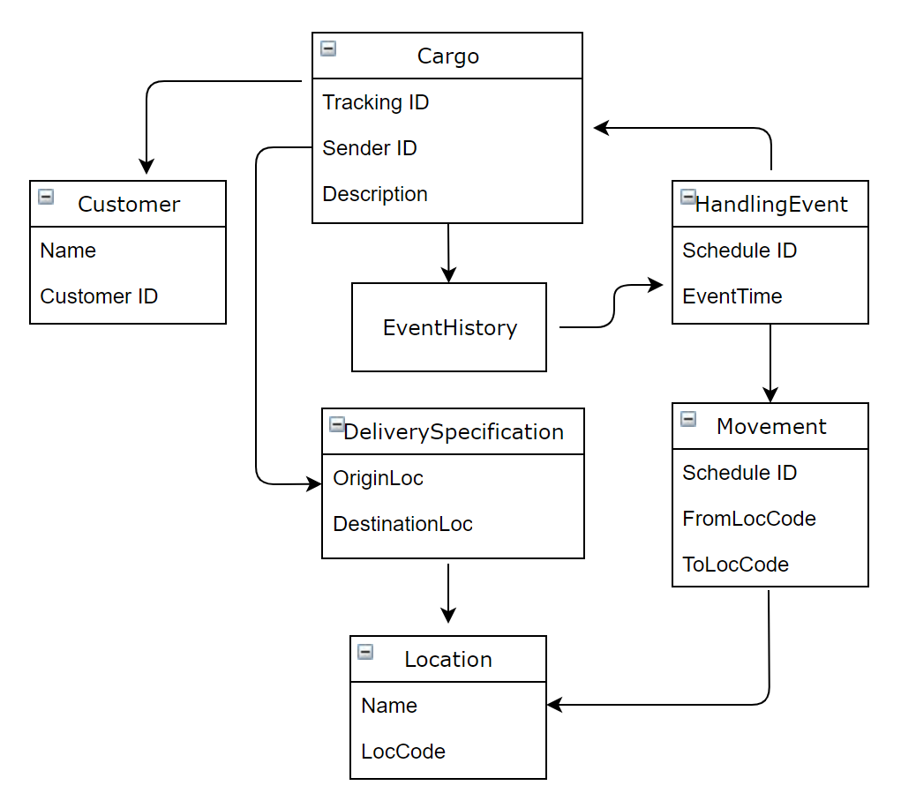
I2EC'20
Improve The Former Design
Step3: Aggregate Boundaries
The Definition of Aggregate:
AGGREGATES mark off the scope within which invariants have to be maintained at every stage of the life cycle.
Invariants cover the relationships between AGGREGATE members
Boundary Rules:
- An AGGREGATE root should have global identity
- Other Members of AGGREGATE has local identity unique only within AGGREGATE
- Other Members of AGGREGATE can not be accessed by Instances outside of the AGGREGATE
- Only root can be directly accessed by requests to database
Roots:
Customer、Cargo、Location、HandlingEvent、Movement
Cargo AGGREGATE contains EventHistory and DeliverySpecification Because they do not exist with a meaning but for cargo
ZheFei Chen

Slide 8
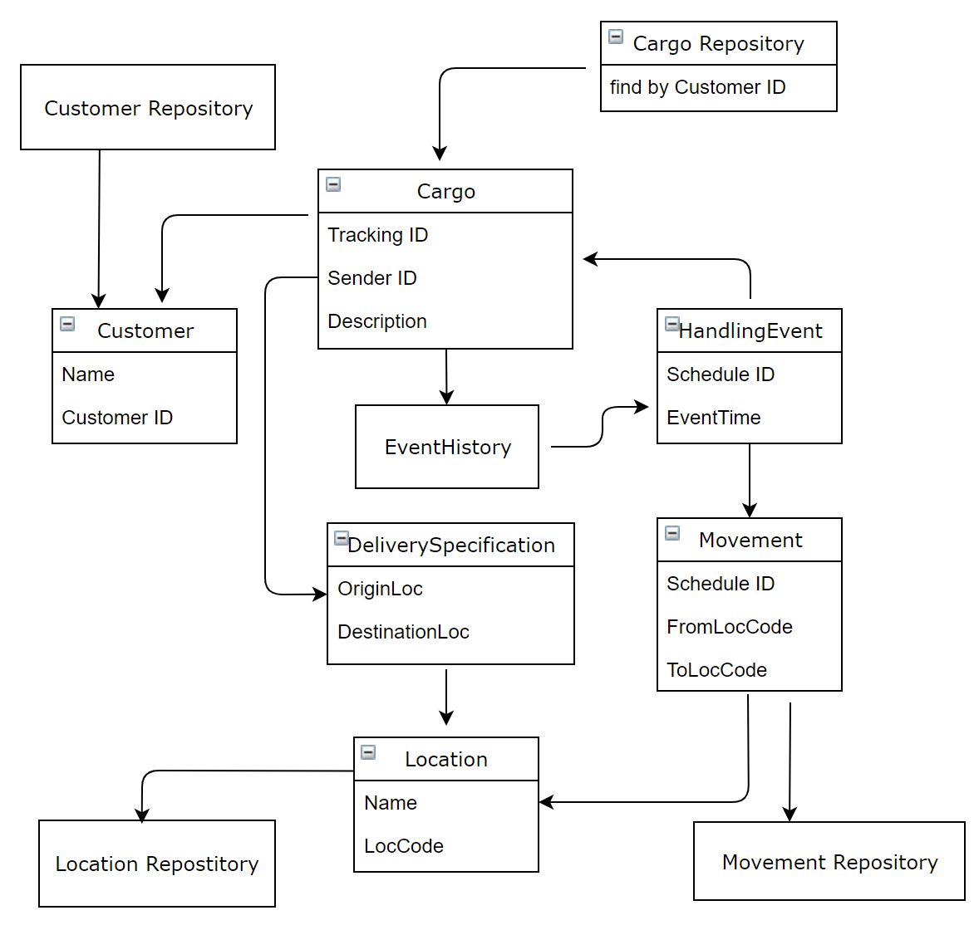
I2EC'20
Improve The Former Design
Step4: Choose Repository
Basic Rule:
Only AGGREGATE roots can have repositories
Confirm the needs for a Repository
- We do not create a Repository for HandlingEvent because we recognize the relationship between EventHistory and HandlingEvent as a Set in the first development iteration
Step5: Check the model in real world
Features of the model:
- When we need to accidentally change the destination, we just drop the old Specification and define a new one, then use the setter method of Cargo to comlete an update
- When we need to create a new Cargo, we only need to consider the objects within Cargo AGGREGATE
ZheFei Chen

Slide 9
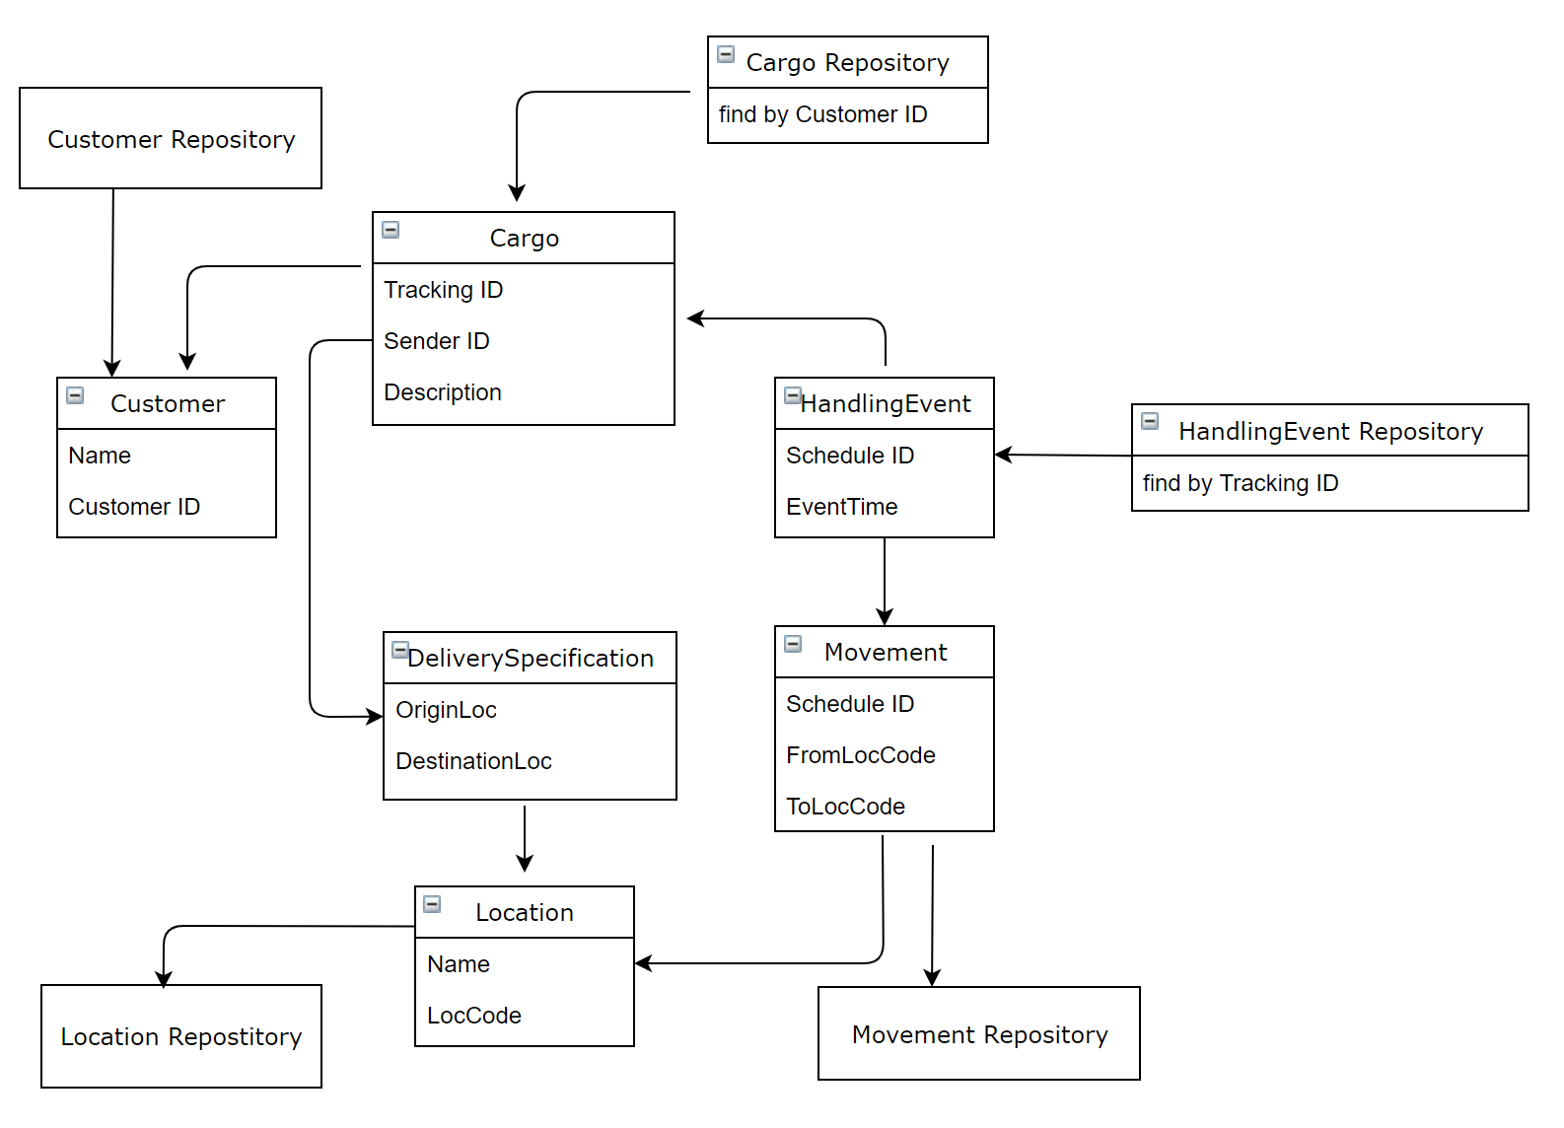
I2EC'20
Improve The Former Design
Step6: Wait and Consider Refactoring
An apparent drawback of the domain design:
Since HandlingEvent handles the EventHistory of Cargo, when we try to add an event to a Cargo while another user is doing the same thing, we get a conflict, either one could be delayed or failed.
Solution:
Add a Repository to HandlingEvent, replacing the Delivery History's collection of Handling Events with a query would allow HandlingEvents to be added without raising any integrity issues outside its own AGGREGATE.
Result:
The Domain Model is more simplified and friendly to use.
ZheFei Chen

Slide 10
I2EC'20
Conclusion
- Using Domain Knowledge helps us get a more concrete understand of the system design and realization
- By dividing domain knowledge precisely and appropriately, we can improve the desired performance of our software system
- Domain-Driven-Design is an iterative process, we can always find somewhere need to be modified according to real world situation to keep the model corresponding to concrete realization
Step7: Keep on Refactoring while developing...
ZheFei Chen

Slide 11
I2EC'20
Thanks!
Q&A
ZheFei Chen

